Slide 1
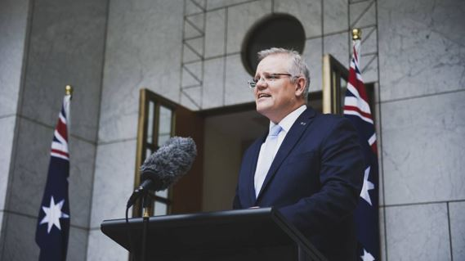
CABINET MEETING UPDATE
“Getting out from under the doona”

Slide 2
3 STEP ROADMAP TO RECOVERY

Slide 3
STEP 2

Slide 4
STEP 3

Slide 5
THE TURNAROUND

Slide 6
“WALK BEFORE WE RUN”
RBA modelling scenario;
8% unemployment mid-2022
2% smaller economy
$160B in mortgages and business loans deferred in 6 months
200,000 businesses
Half the workforce is on Jobkeeper or Jobseeker
1M extra people on welfare

Slide 7
THE WAY FORWARD
STEP 1: $3.1B and 250K jobs per month
STEP 2: $3B and 275K jobs per month
STEP 3: $3.3B and 325K jobs per month
International travel a long way off
But for foreign students (considering in step 3)

Slide 8
THE TURNAROUND

Slide 9
NEW DAWNING

