Slide 1
ARE BANKS LENDING AND AM I PAYING TOO MUCH?

Slide 2
CURRENT RATES - RESIDENTIAL OWNER OCCUPIED
VARIABLE
2.79% - 2.85% - Principal and Interest
3.50% - 3.55% - Interest Only
FIXED
2 YEARS: 2.19% - 2.25% - Principal and Interest
3 YEARS: 2.29% - 2.49% - Principal and Interest
3 YEARS: 2.95% - Interest Only

Slide 3
CURRENT RATES - RESIDENTIAL INVESTMENT
VARIABLE
Between 3.05% - 3.14% - Principal and Interest
OR
Between 3.05% - 3.59% - Interest Only
FIXED
2 years - 2.64% - Principal and Interest
3 years - 2.69% - Principal and Interest
2 years - 2.79% - Interest Only
Cash back offering with some lenders range from $1,500 - $4,000 per security

Slide 4
CURRENT RATES – COMMERCIAL/BUSINESS LOANS
VARIABLE
Between 4.79% - 5.59% - Principal and Interest
OR
2 - 3 year 2.59% - Principal and Interest

Slide 5
PEOPLE HAVE LESS MONEY

Slide 6
HOUSE VALUES

Slide 7
HIGH END HURTING

Slide 8
CAPITAL CITY MARKETS DECLINING

Slide 9
SYDNEY

Slide 10
MELBOURNE

Slide 11
BRISBANE

Slide 12
ADELAIDE

Slide 13
PERTH

Slide 14
HOBART

Slide 15
DARWIN

Slide 16
ACT

Slide 17
SETTLED SALES

Slide 18
SALES VOLUMES

Slide 19
VENDOR DISCOUNTING

Slide 20
NEW LISTINGS

Slide 21
TOTAL LISTINGS

Slide 22
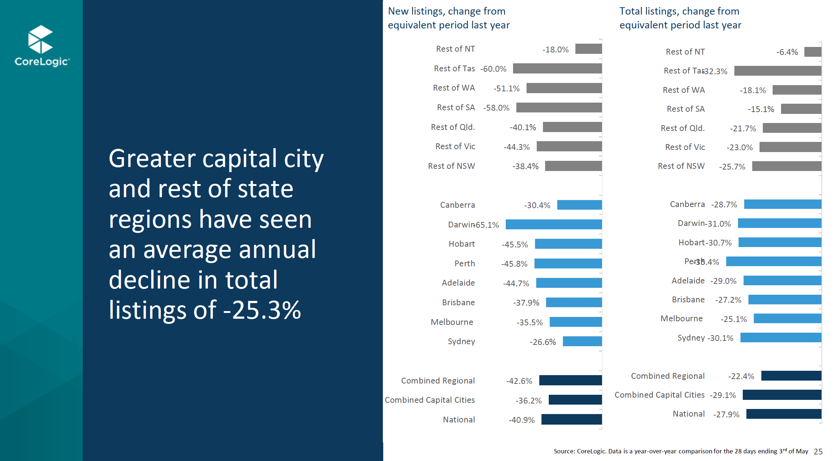
REGIONAL

Slide 23
CLEARANCE RATES

Slide 24
FEWER AUCTIONS SCHEDULED

Slide 25
LENDING CONDITIONS

Slide 26
NEW LENDING

