Slide 1
Housing market update
Property Investor Summit
February 2018
Tim Lawless
tim.lawless@corelogic.com.au
@timlawless

Slide 2
Housing: Australia’s most valuable asset class
Number of dwellings
9.9 million
Residential Real Estate
$7.6 Trillion
Outstanding mortgage debt
$1.72 trillion
Australian Superannuation
$2.5 Trillion
Household wealth held in housing
52.2%
Australian Listed Stocks
$1.9 Trillion
Commercial Real Estate
$0.948 Trillion
Total sales p.a.
466,176
Gross value of
sales p.a.
$299.3 billion
Source: CoreLogic, RBA, ASX, ABS, APRA

Slide 3
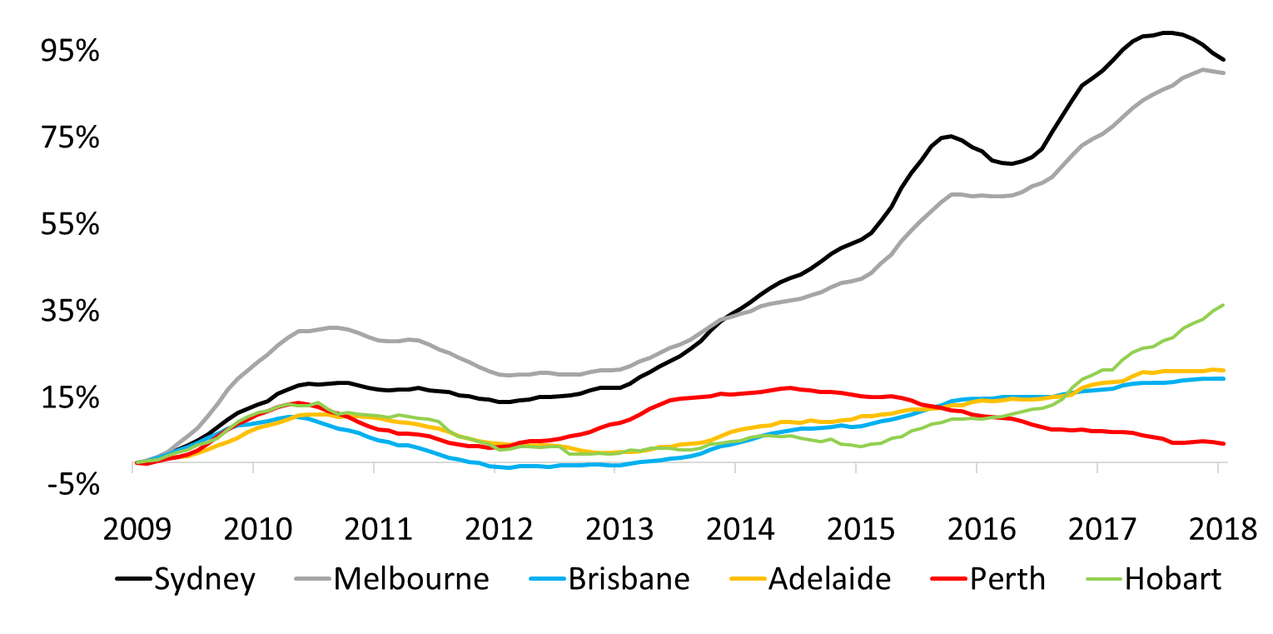
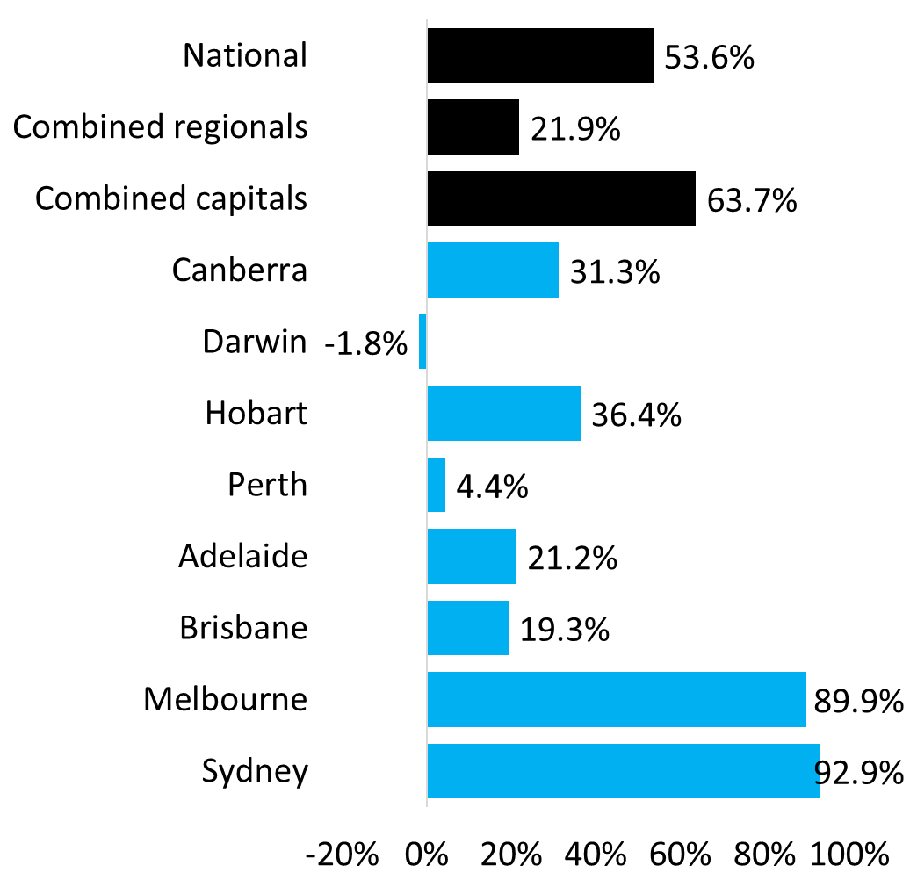
The past nine years have seen capital gains significantly skewed towards Sydney and Melbourne
Cumulative change in dwelling values post GFC
(Jan 2009 to Jan 2018)
Source: CoreLogic

Slide 4
Poll Question One
Sydney and Melbourne have dominated capital gains over the past two cycles, but which city is likely to be the strongest performer over the coming five years?
Sydney
Melbourne
Brisbane
Adelaide
Perth
Hobart
Darwin
Canberra
Other (regional market)

Slide 5
Victoria and New South Wales accounted for three quarters of jobs created nationally over the past five years
Jobs growth by state, 2012 to 2017
Jobs growth by state, long-term
Source: CoreLogic, ABS

Slide 6
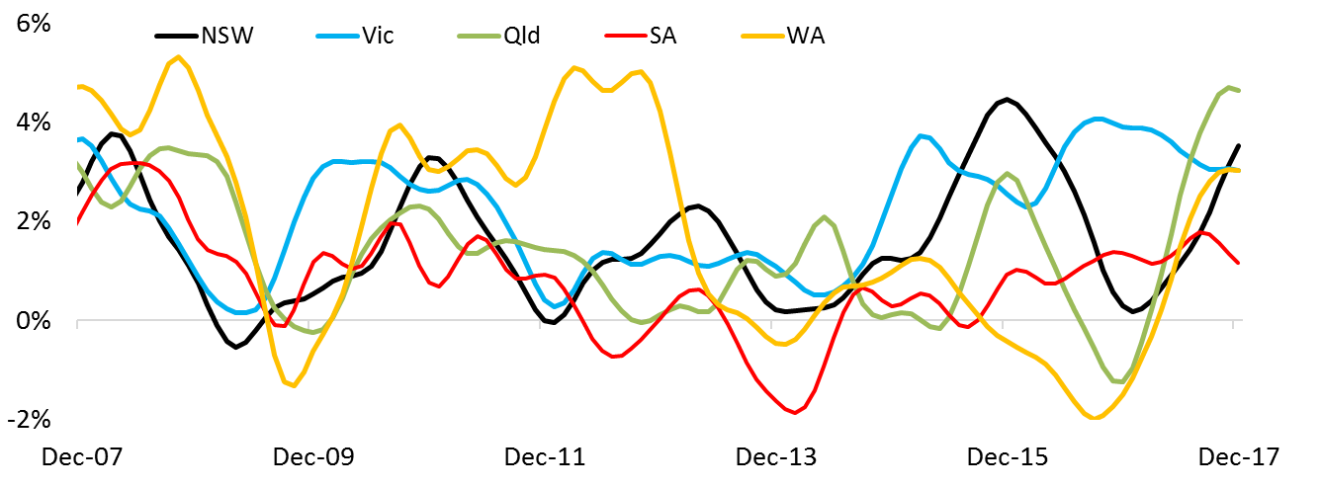
Jobs growth is now more broad based, with stronger jobs creation spreading outside of Vic and NSW
Annual change in trend employment
Share of total job creation, 12 months to December 2017
Source: CoreLogic, ABS

Slide 7
Victoria and New South Wales accounted for almost two thirds of Australia’s population growth over the past five years
Share of national population growth
2012 to 2017
Share of national population growth
long-term
Source: CoreLogic, ABS

Slide 8
Queensland now leads the nation in terms of net interstate migration
Source: CoreLogic, ABS

Slide 9
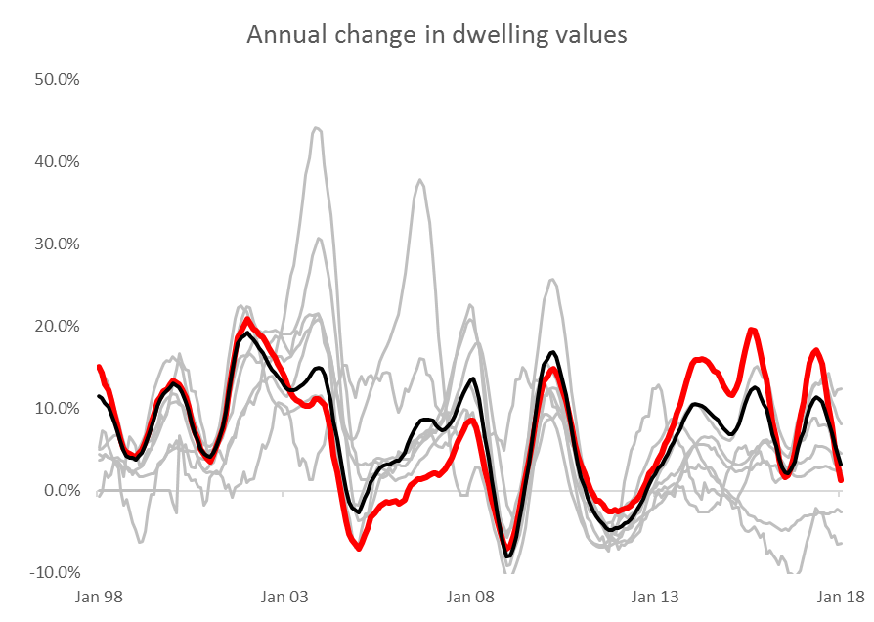
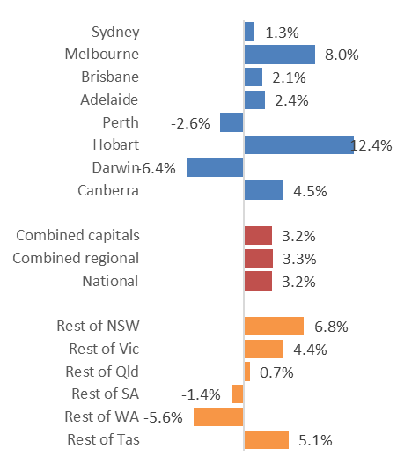
Combined
capitals
Sydney
Source: CoreLogic

Slide 10
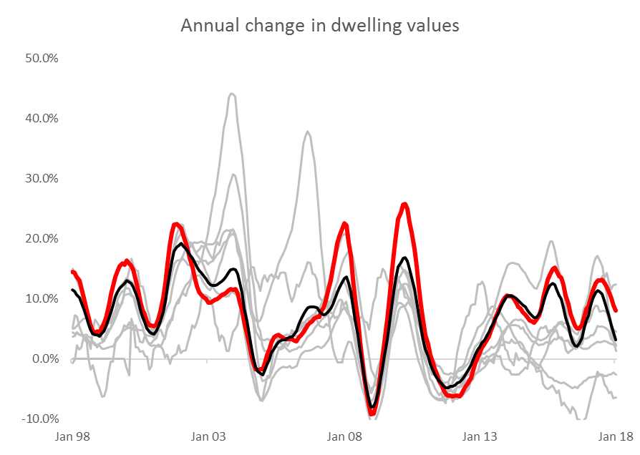
Combined
capitals
Melbourne
Source: CoreLogic

Slide 11
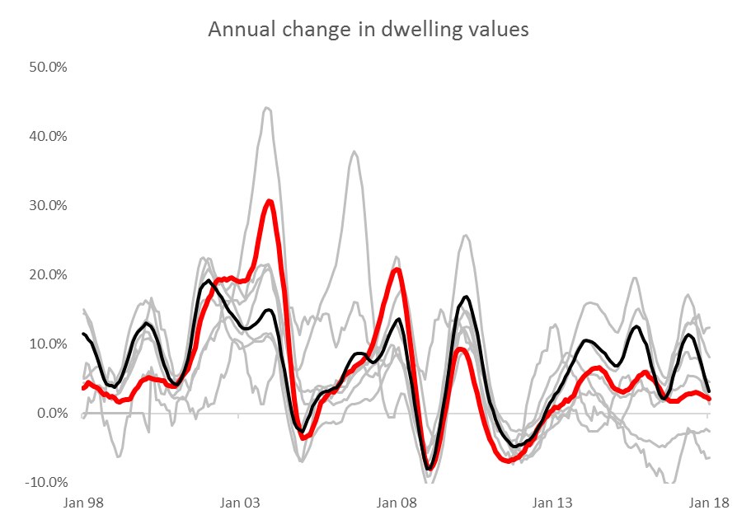
Combined
capitals
Brisbane
Source: CoreLogic

Slide 12
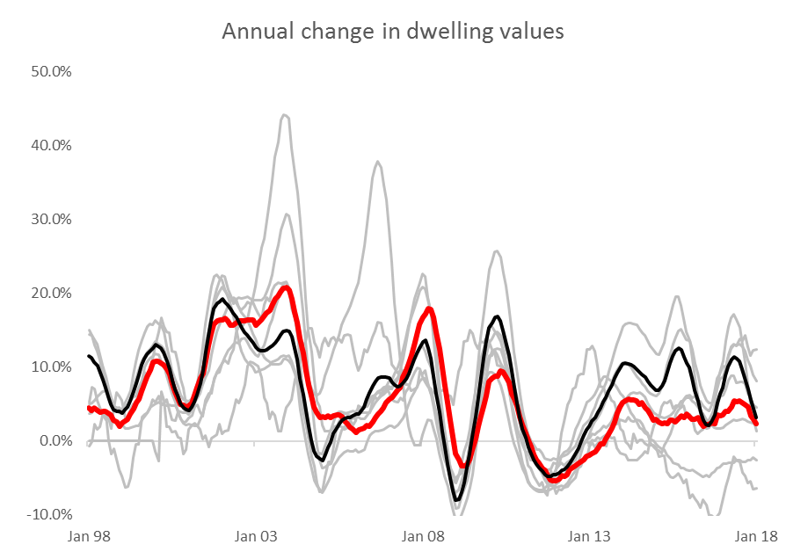
Combined
capitals
Adelaide
Source: CoreLogic

Slide 13
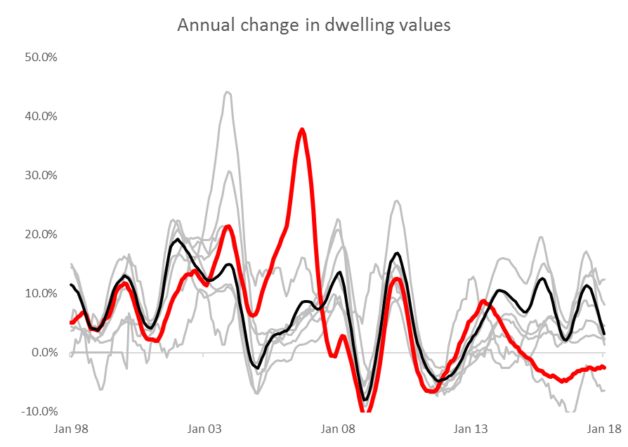
Combined
capitals
Perth
Source: CoreLogic

Slide 14
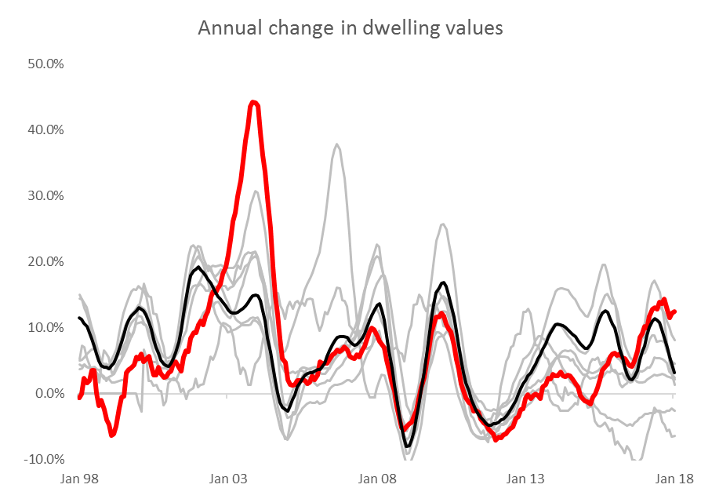
Combined
capitals
Hobart
Source: CoreLogic

Slide 15
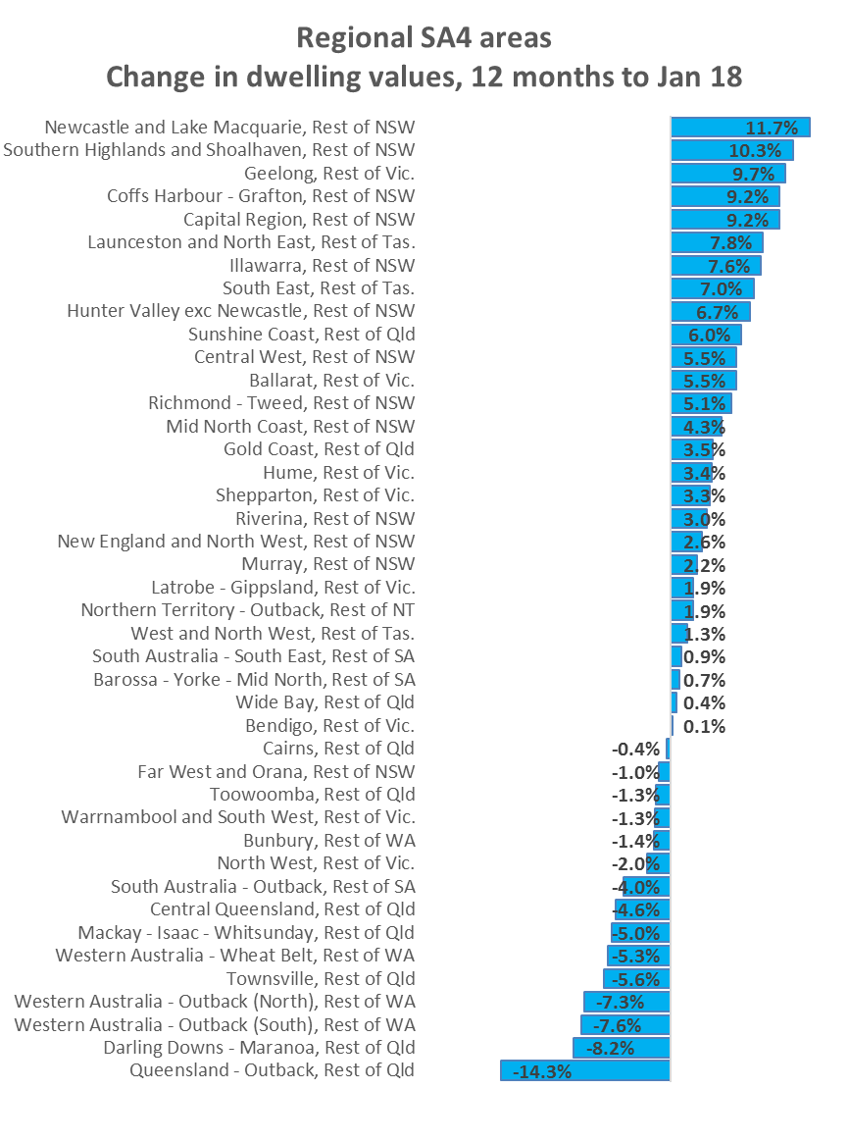
Conditions are diverse outside of the capitals.
Satellite cities and coastal markets have generally shown the strongest growth rates over the past twelve months

Slide 16
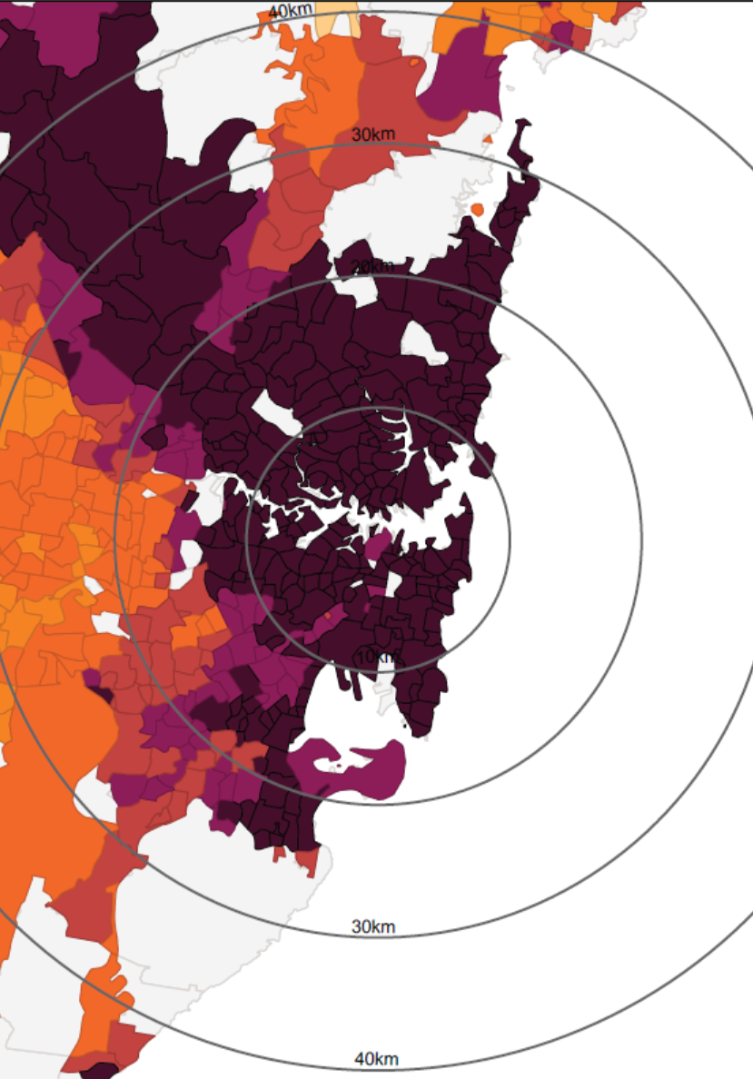
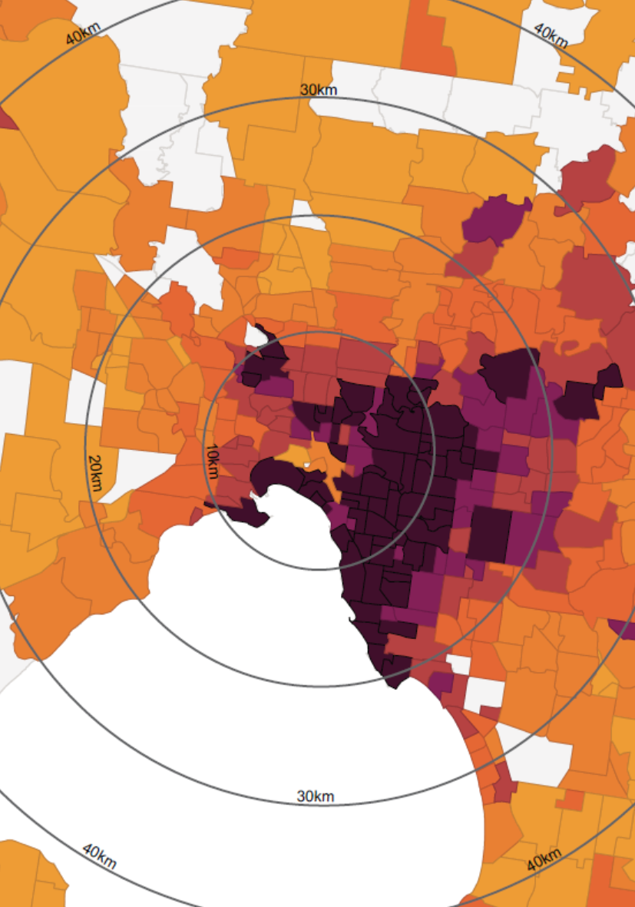
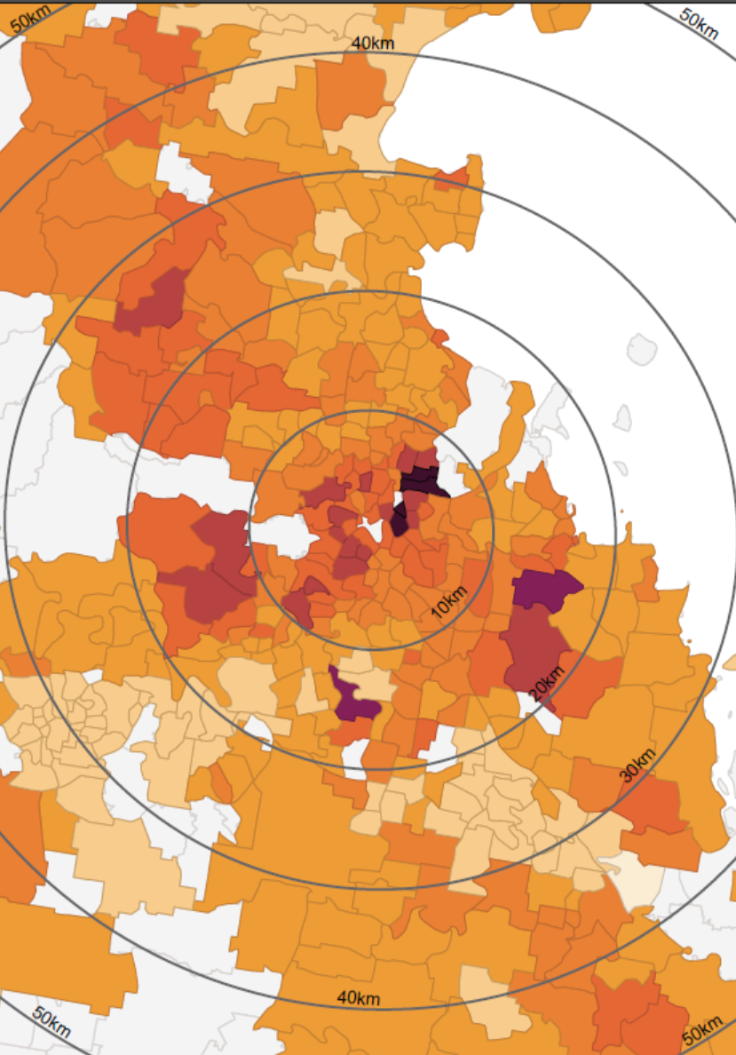
Housing affordability has become challenging across Sydney, and to a lesser extent, Melbourne
Sydney
Melbourne
Brisbane
<200k
200k <400k
400k <600k
600k <800k
800k <1m
1m <1.2m
1.2m <1.4m
>1.4m
Source: CoreLogic

Slide 17
Source: CoreLogic

Slide 18
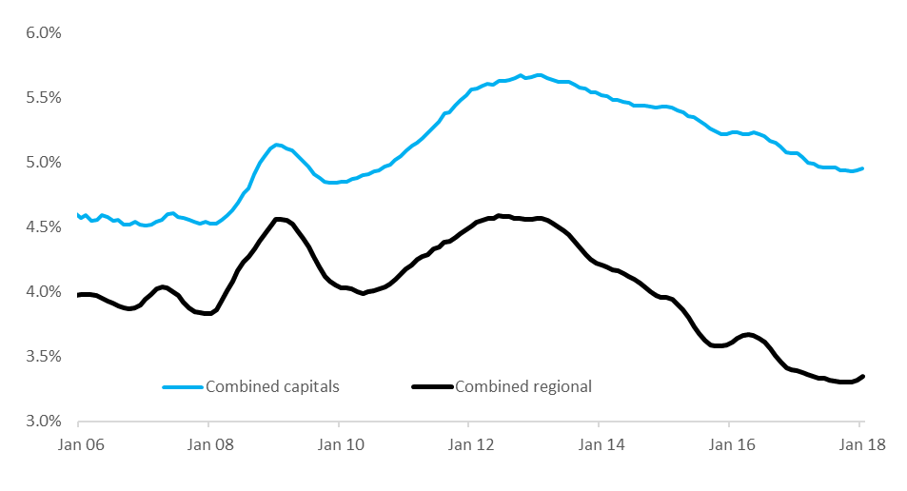
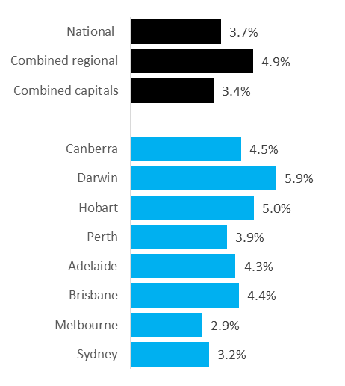
Gross rental yields have trended lower over recent years as value growth has outpaced rental growth
Gross rental yields
Gross rental yields as at Aug-17
Source: CoreLogic

Slide 19
Poll Question Two
Are rental yields an important consideration for you when considering investment opportunities?
Yields are my highest priority when making an investment decision
Yield is important, but prospects for capital gain are more important
I don’t care about the rental yield, its all about location and prospects for capital gain
I prefer a balanced approach to yields and capital gain

Slide 20
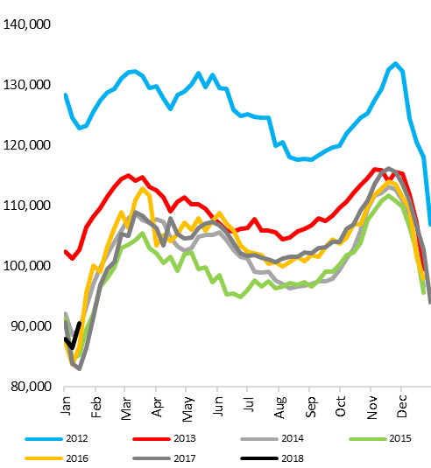
Listing numbers are starting to trend higher in some cities, reducing urgency and enabling buyers to negotiate
Total advertised listings (rolling 28 day count), combined capitals
Number of new and total properties advertised for sale, 28 days to 29 January 2018
Source: CoreLogic

Slide 21
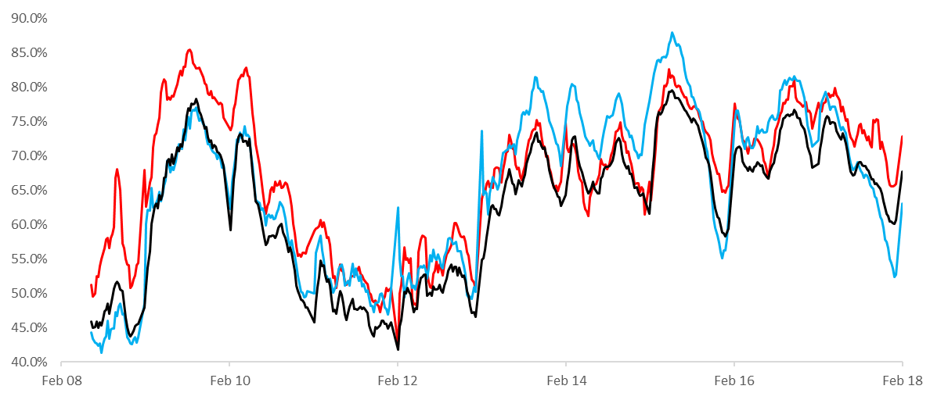
Auction clearance rates were trending lower throughout most of 2017 but have started 2018 on a stronger footing
Auction clearance rates (four week average)
Melbourne
Sydney
All capitals weighted average
Source: CoreLogic

Slide 22
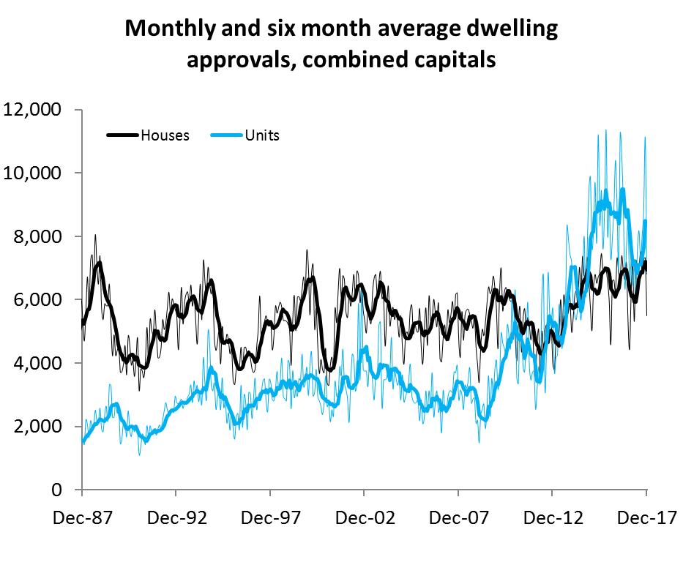
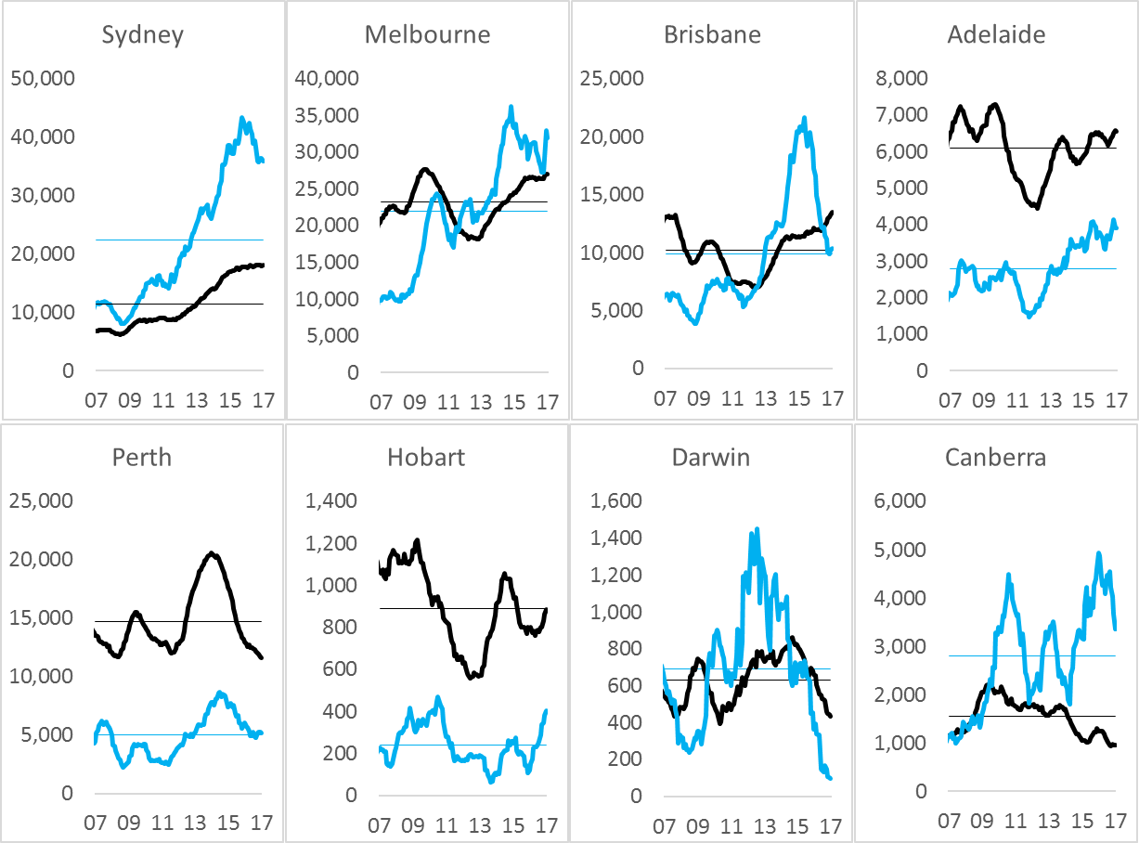
Apartment supply remains elevated in some markets, but approvals are generally trending lower
Source: CoreLogic, ABS

Slide 23
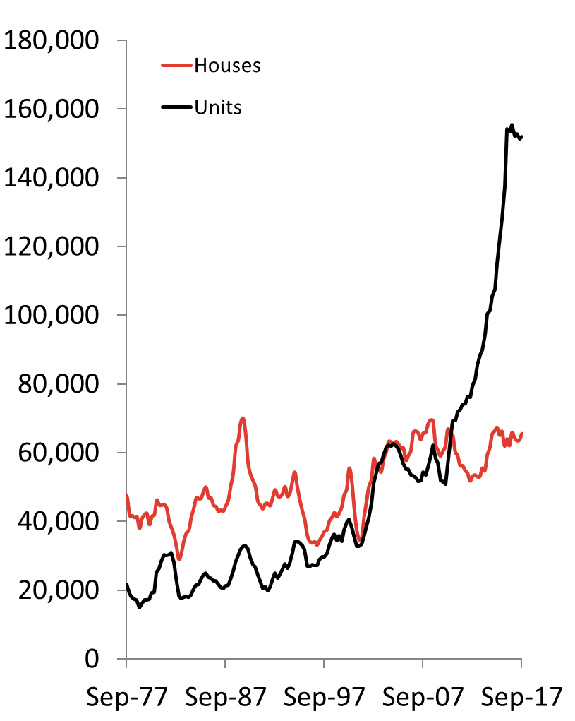
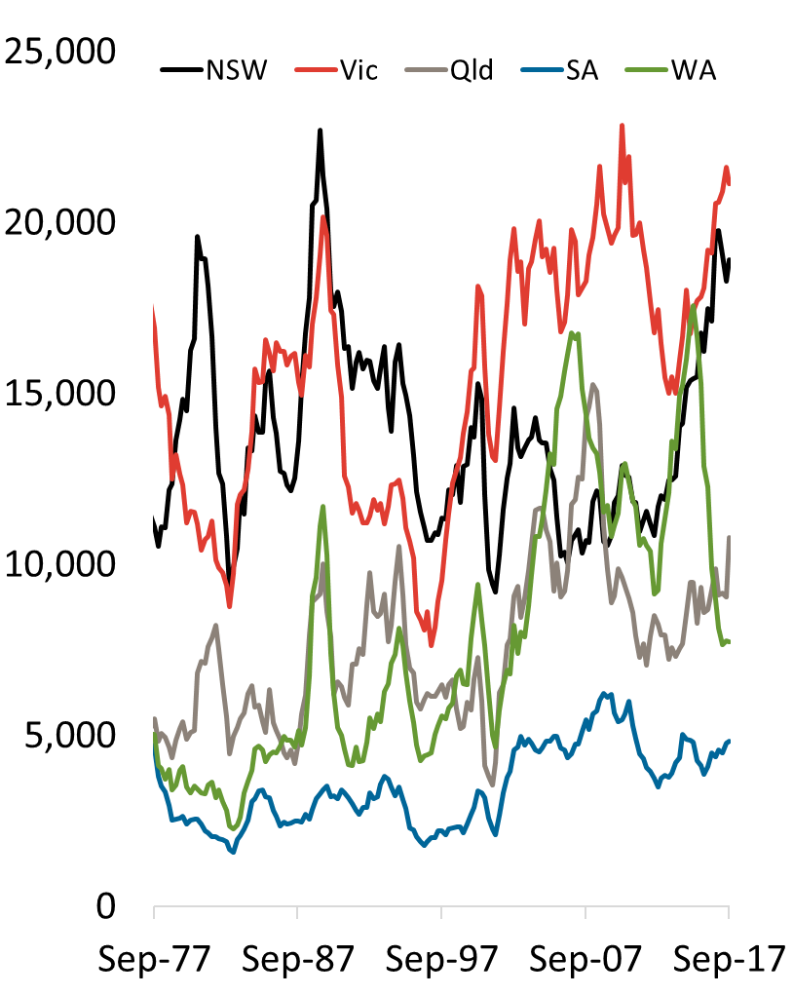
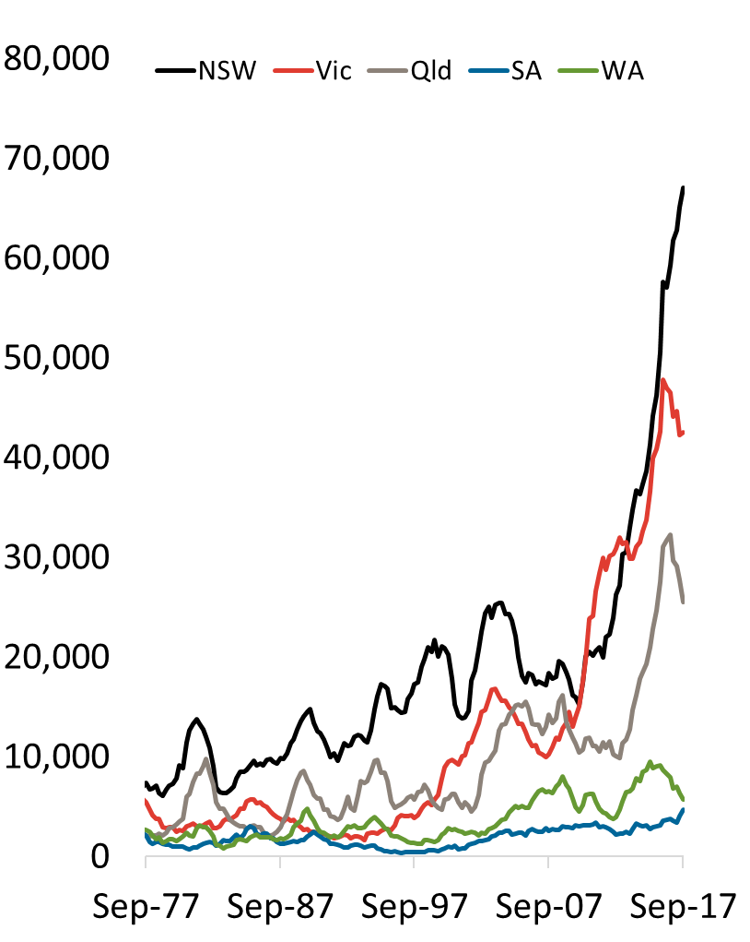
The pipeline of new unit supply remains close to record highs
Houses and units under construction, national
Houses under construction by state
Units under construction by state
Source: CoreLogic, ABS

Slide 24
Poll Question Three
I think off the plan unit markets are:
Substantially oversupplied
Oversupplied within specific areas / product types
Supply is appropriate relative to demand
Undersupplied

Slide 25
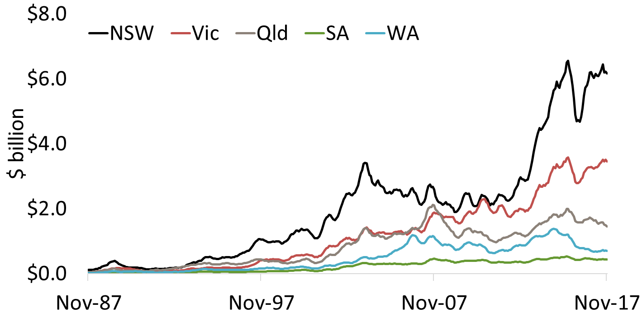
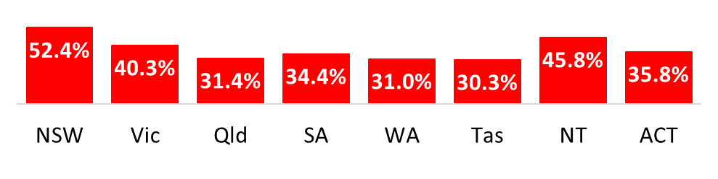
A slowdown in investment demand will have a more substantial effect on Sydney and Melbourne where investment is most concentrated.
6 month average value of lending to investors
% of total lending (ex refinances) to investors
Source: CoreLogic, ABS

Slide 26
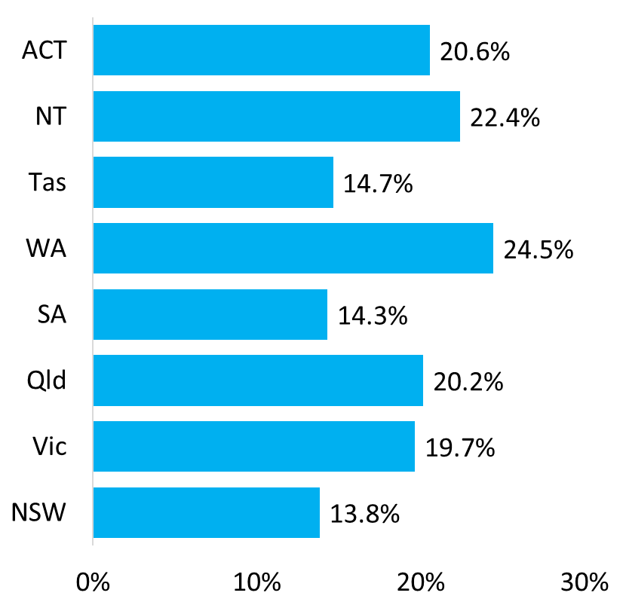
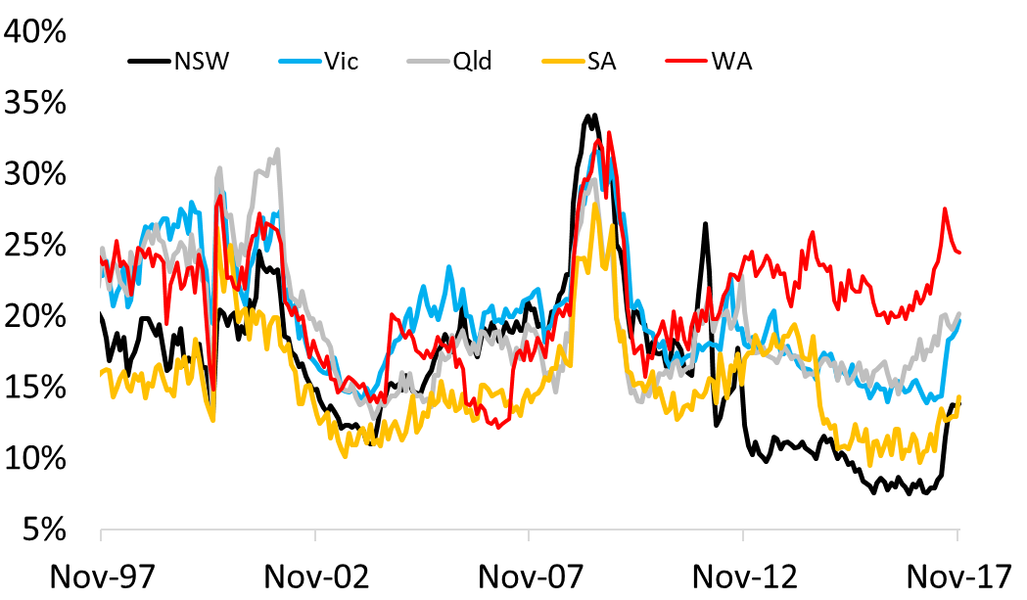
First home buyers have shown a sharp response to stamp duty concessions in NSW and Vic
First home buyers as a % of all owner occupier housing finance commitments, Nov 2017
First home buyers as a % of all owner occupier housing finance commitments
Source: CoreLogic, ABS

Slide 27
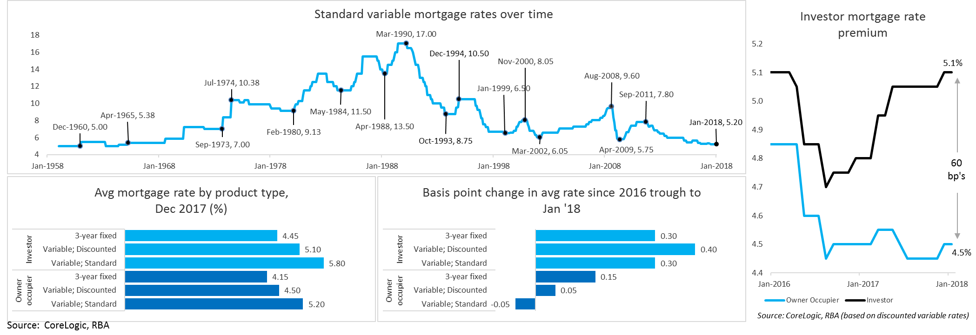
Mortgage rates remain around historic lows for owner occupiers but are 60 bp’s higher for investors
Source: CoreLogic, RBA

Slide 28
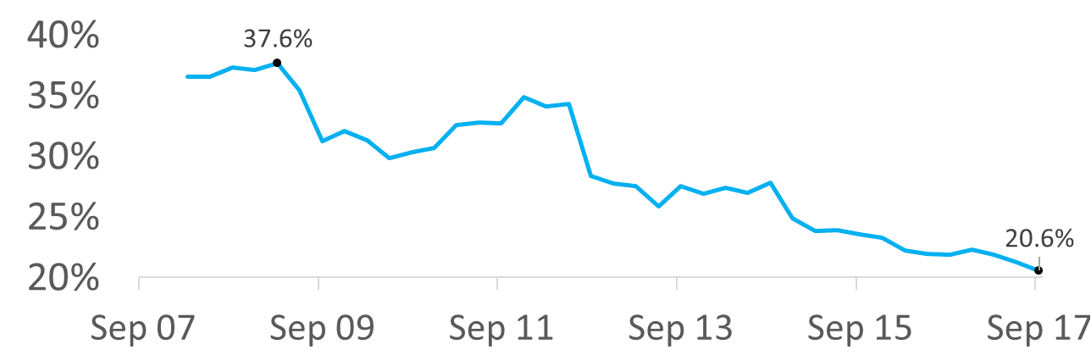
Regulatory changes and higher mortgage rates have impacted on investment demand and interest-only demand has shrunk significantly
Annual change in housing credit
% of mortgages originated on interest only terms
APRA 10% speed limit
% of mortgages settled with an LVR>=80%
APRA 30% origination target
Source: CoreLogic, APRA, RBA

Slide 29
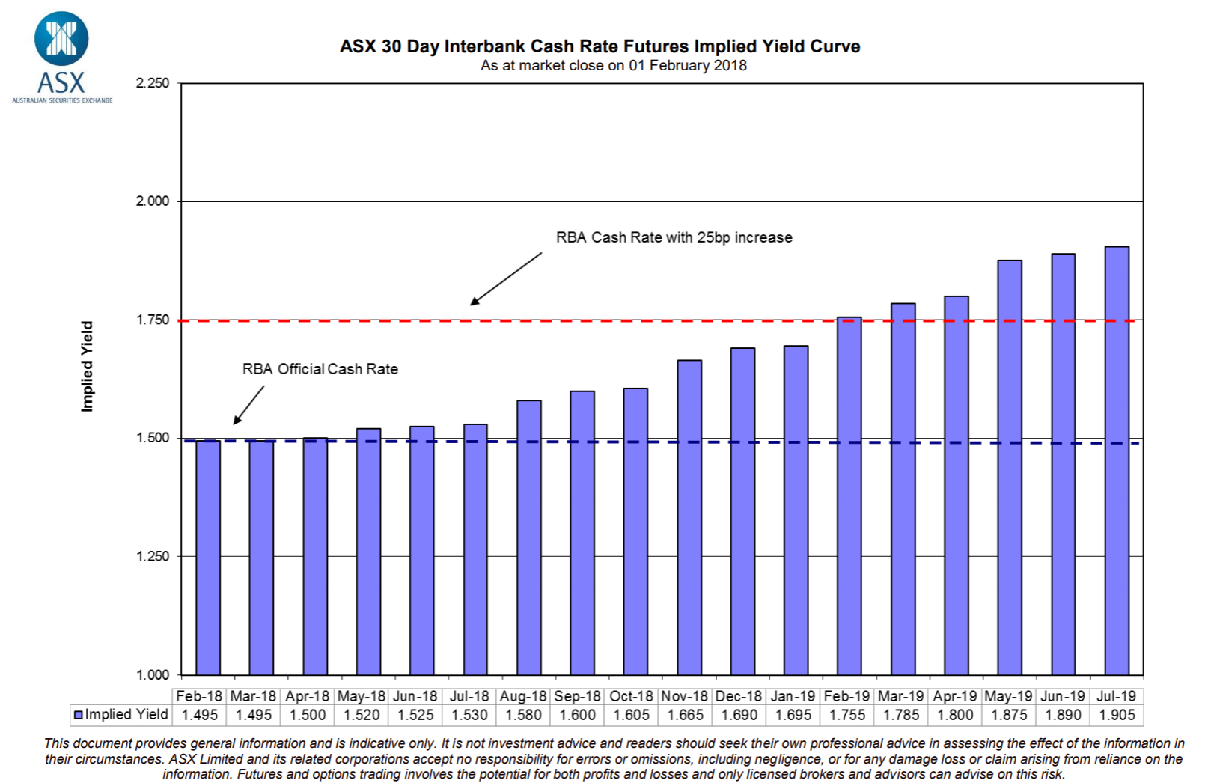
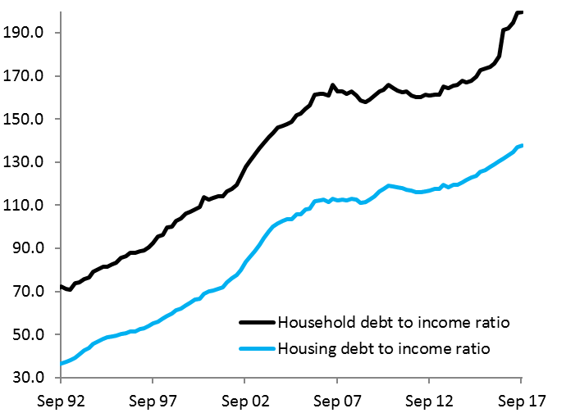
Mortgage rates likely to remain low
Household debt to disposable income ratio
Source: CoreLogic, ABS

Slide 30
Poll Question four
My views on the local market going forward with regards to annual capital gains
At least 10% growth over the next year
Values to rise 5-10%
Values will rise but less than 5%
Values will fall but not by more than 5%
Values will by 5-10%
Values will fall by more than 10%
Not sure

Slide 31
Where to from here?
Sydney has moved through its peak growth phase, but expecting a controlled slowdown and only moderate fall in dwelling values.
Melbourne more resilient, but also slowing.
Hobart has been the standout for capital gains, but its growth run is likely to ease in 2018.
Perth is likely approaching the bottom of its downturn.
Brisbane and Adelaide recording modest capital gains.
Caution around inner city unit markets, particularly Brisbane, Melbourne and Perth.
Higher demand from owner occupiers may help to offset a slowdown in investment activity.
Regional lifestyle markets are rebounding strongly and satellite cities are performing well.
Resource driven markets are showing signs of improved conditions but a recovery will take a long time.

Slide 32
About Us
CoreLogic Australia is a wholly owned subsidiary of CoreLogic (NYSE: CLGX), which is the largest property data and analytics company in the world. CoreLogic provides property information, analytics and services across Australia, New Zealand and Asia, and recently expanded its service offering through the purchase of project activity and building cost information provider Cordell. With Australia’s most comprehensive property databases, the company’s combined data offering is derived from public, contributory and proprietary sources and includes over 500 million decision points spanning over three decades of collection, providing detailed coverage of property and other encumbrances such as tenancy, location, hazard risk and related performance information.
With over 20,000 customers and 150,000 end users, CoreLogic is the leading provider of property data, analytics and related services to consumers, investors, real estate, mortgage, finance, banking, building services, insurance, developers, wealth management and government. CoreLogic delivers value to clients through unique data, analytics, workflow technology, advisory and geo spatial services. Clients rely on CoreLogic to help identify and manage growth opportunities, improve performance and mitigate risk. CoreLogic employs over 650 people across Australia and in New Zealand. For more information call 1300 734 318 or visit www.corelogic.com.au
CoreLogic produces an advanced suite of housing market analytics that provides key insights for understanding housing market conditions at a granular geographic level. Granular data is often used for portfolio analysis and benchmarking, risk assessments and understanding development feasibility and market sizing. It gives industry professionals valuable modules which provide essential analytics and insights for decision making and strategy formation within the residential property asset class. We can tailor reports to suit your business requirements.
Call us on 1300 734 318 or email us at ask@corelogic.com.au or visit us at www.corelogic.com.au

Slide 33
Granular Data and Analytics
Market Scorecard: Monitor and measure market share and performance of real estate agents at an individual office or a Franchise brand level across Australia. Identify the competing brands and independents at a suburb, postcode, user defined territory and State level. Easily locate growth opportunities and market hotspots, and view the performance of the established offices in these new areas of interest.
Market Trends: Detailed housing market indicators down to the suburb level, with data in time series or snapshot and segmented across houses, units and land. The Market Trends data includes key housing market metrics such as median prices, median values, transaction volumes, rental statistics, vendor metrics such as average selling time and vendor discounting rates.
CoreLogic Indices: The suite of CoreLogic Indices range from simple market measurements such as
median prices through to repeat sales indices and our flagship hedonic home value indices. The CoreLogic Hedonic index has been specifically designed to track the value of a portfolio of properties over time and is relied upon by Australian regulators and industry as the most up to date and accurate measurement of housing market performance.
Economist Pack: A suite of indices and indicators designed specifically for Australian economic commentators who require the most up to date and detailed view of housing market conditions. The economist pack includes the CoreLogic Hedonic indices for capital cities and ‘rest of state’ indices, the stratified hedonic index, hedonic total return index, auction clearance rates and median prices.
Investor Concentration Report: Understanding ownership concentrations is an important part of assessing risk. Areas with high investor concentrations are typically allocated higher risk ratings due to the over-representation of a particular segment of the market. Through a series of rules and logic, CoreLogic RP Data has flagged the likely ownership type of every residential property nationally as either owner occupied, investor owned or government owned.
Mortgage Market Trend Report: CoreLogic RP Data is in a unique position to monitor mortgage related housing market
activity. Transaction volumes, dwelling values and mortgage related valuation events all comprise our Mortgage market
trend report which provides an invaluable tool for mortgage industry benchmarking and strategy.

Slide 34
Disclaimer
In compiling this publication, RP Data Pty Ltd trading as CoreLogic has relied upon information supplied by a number of external sources. CoreLogic does not warrant its accuracy or completeness and to the full extent allowed by law excludes liability in contract, tort or otherwise, for any loss or damage sustained by subscribers, or by any other person or body corporate arising from or in connection with the supply or use of the whole or any part of the information in this publication through any cause whatsoever and limits any liability it may have to the amount paid to CoreLogic for the supply of such information.
Queensland Data
Based on or contains data provided by the State of Queensland (Department of Natural Resources and Mines) 2018. In consideration of the State permitting use of this data you acknowledge and agree that the State gives no warranty in relation to the data (including accuracy, reliability, completeness, currency or suitability) and accepts no liability (including without limitation, liability in negligence) for any loss, damage or costs (including consequential damage) relating to any use of the data. Data must not be used for direct marketing or be used in breach of the privacy laws.
South Australian Data
This information is based on data supplied by the South Australian Government and is published by permission. The South Australian Government does not accept any responsibility for the accuracy or completeness of the published information or suitability for any purpose of the published information or the underlying data.
New South Wales Data
Contains property sales information provided under licence from the Land and Property Information (“LPI”). CoreLogic is authorised as a Property Sales Information provider by the LPI.
Victorian Data
The State of Victoria owns the copyright in the Property Sales Data which constitutes the basis of this report and reproduction of that data in any way without the consent of the State of Victoria will constitute a breach of the Copyright Act 1968 (Cth). The State of Victoria does not warrant the accuracy or completeness of the information contained in this report and any person using or relying upon such information does so on the basis that the State of Victoria accepts no responsibility or liability whatsoever for any errors, faults, defects or omissions in the information supplied.
Western Australian Data
Based on information provided by and with the permission of the Western Australian Land Information Authority (2018) trading as Landgate.
Australian Capital Territory Data
The Territory Data is the property of the Australian Capital Territory. No part of it may in any form or by any means (electronic, mechanical, microcopying, photocopying, recording or otherwise) be reproduced, stored in a retrieval system or transmitted without prior written permission. Enquiries should be directed to: Director, Customer Services ACT Planning and Land Authority GPO Box 1908 Canberra ACT 2601.
Tasmanian Data
This product incorporates data that is copyright owned by the Crown in Right of Tasmania. The data has been used in the product with the permission of the Crown in Right of Tasmania. The Crown in Right of Tasmania and its employees and agents:
a) give no warranty regarding the data's accuracy, completeness, currency or suitability for any particular purpose; and
b) do not accept liability howsoever arising, including but not limited to negligence for any loss resulting from the use of or reliance upon the data.
Base data from the LIST © State of Tasmania http://www.thelist.tas.gov.au

Slide 35


Thank You

